Slide 1
Solving MNP problem of GFL

Slide 2
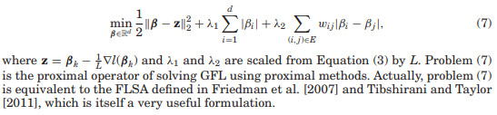
Review

Slide 3
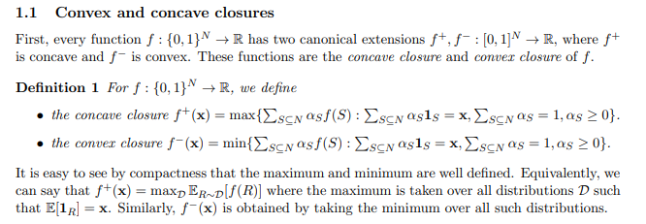
Lov ´asz extension

Slide 4
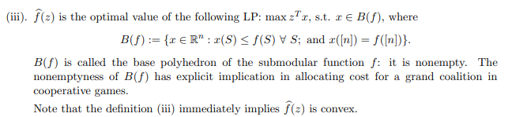
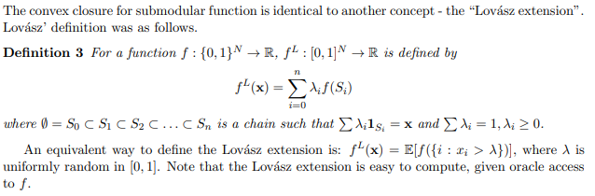

Slide 5
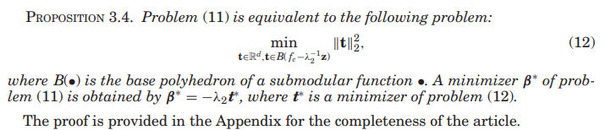
the known fastest time complexity of submodular minimization is O(d5EO + d6) [Orlin 2009], where EO is the cost for a function evaluation, and thus this approach to high-dimensional problems is infeasible in practice

Slide 6
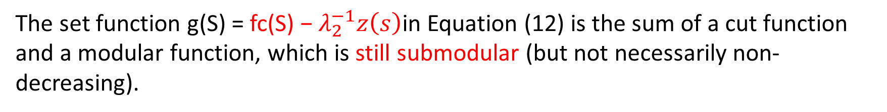
Parametric Graph Cut
=> parametric flow algorithm
The set function g(S) = fc(S) − $λ_{2}^{−1}z\left(s\right)$in Equation (12) is the sum of a cut function and a modular function, which is still submodular (but not necessarily non-decreasing).
separable convex minimization problem under submodular constraints
=> Solvable by parametric optimization

Slide 7
For a parameter α ≥ 0, we define a set function gα(S) = g(S) − α · 1(S). Now that we have assumed that g is a nondecreasing submodular function, there exists l + 1 (≤ d) subsets
and l + 1 subintervals of
for each i ∈ V with i ∈ Sj+1 \ Sj (j ∈ {1,...,l − 1}). Thus, by computing the unique maximal minimizer of gα for some appropriately selected αs, we can find all Sj and therefore compute t∗. A possible option for finding all “appropriate” αs would be to apply the decomposition algorithm [Fujishige 2005; Nagano and Aihara 2012], which recursively finds all Sjs

Slide 8
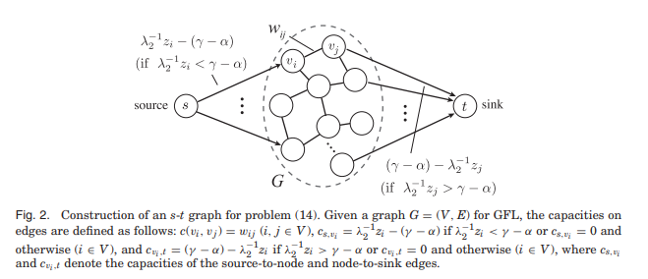

Slide 9


, we have a nondecreasing submodular function g/ = g + γ 1. Then, after we have found the minimizer of the MNP under the constraint of g/ , i.e., t∗ +γ 1, we can apply Lemma 3.5 to obtain a solution of the original problem.

Slide 10
the capacities on source-to-node or node-to-sink edges have the following properties:
the capacities on source-to-node edges are nondecreasing functions of α,
(2) the capacities on node-to-sink edges are nonincreasing functions of α, and
(3) the capacities on node-to-node edges are constant with respect to α
reported by Gallo et al. [1989]
=> α only affects the edges from the source node or to the sink node, we do not need to search αs that yield different solutions.

